Slide 1
Business Analysis & Process Management
By Mahi Ismail

Slide 2
What are your current business needs?

Slide 3
Steps for identifying your business needs
Define your business
What are the products and/or services offered?
Who are the target customers?
What are your strategic goals?
Where are you now in achieving your goals?
What is your current status in the market?

Slide 4
Task 2 Visuals

Slide 5
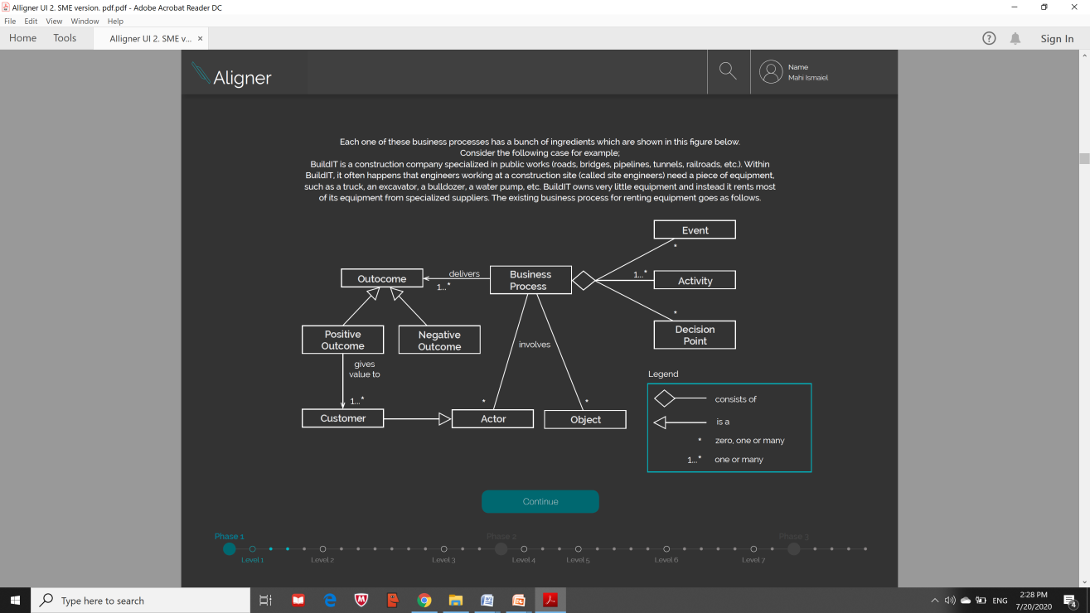

Slide 6
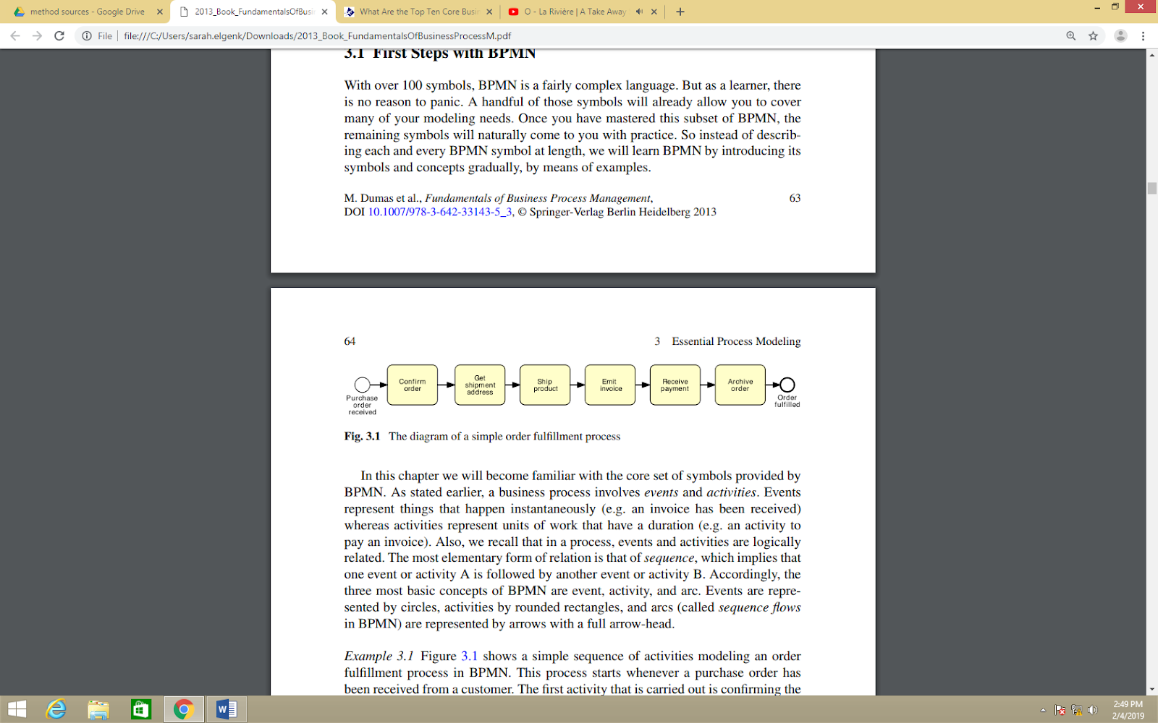
The Diagram of Simple Fulfillment Process

Slide 7
Stakeholders in the sales process
Buyer & Seller (supplier and customer)
Shipping company
Bank

